Slide 1
LEDGER-BASED NETWORK FOR DOCUMENT DISTRIBUTION (LEDGENDD™)
Securing Document Dissemination in the Defense RDT&E Community
NIRA, Inc.
Wen Zhu wzhu@nira-inc.com 15 Jun 2022

Slide 2
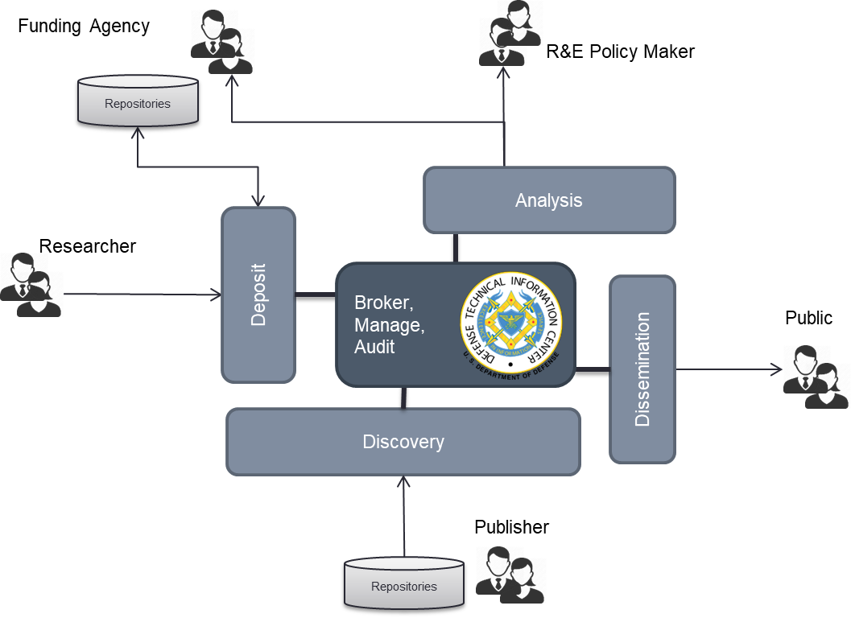
Information Dissemination in Defense Research Development Test and Evaluation (RDT&E) Community
DTIC is the authoritative source and secure custodian of defense research and engineering data
Public Data – e.g. budget information
Proprietary Data – e.g. research proposal
Sensitive Data – e.g. controlled unclassified technical report
DTIC collaborates with DoD, government, and industry partners

Slide 3
What problems are we addressing?
Continual Access Control
Once downloaded, user is free to edit and forward documents without the knowledge of the repository administrator
Accidental Leak Prevention
No ability to recall or force document expiration
Distribution Insights
No knowledge on how document is shared and redistributed once it leaves agency enclave
Infrastructure Resiliency
Centrally managed security administration as the single point of failure in enterprise security, even with cloud deployment
Repository
User
Document

Slide 4
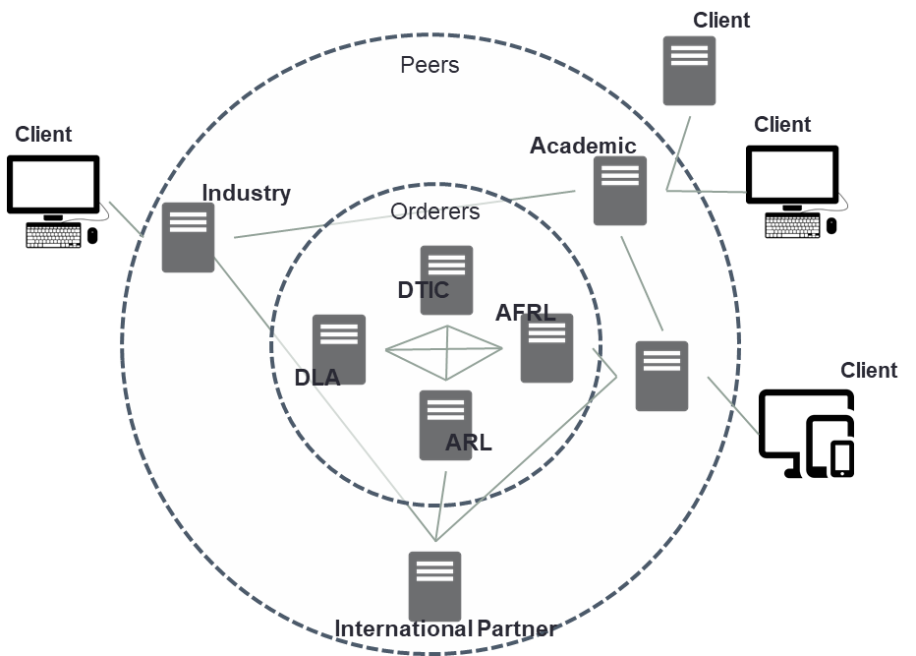
Why blockchain?
Industry Benchmark: Highly Available and Scalable
Reliably and securely improves information availability and removes single points of failure in system configuration
Tamper-resistant Logging
Maintains chain-of-custody and audit trail of system access
Consistent Contract Execution
Enforces inter-organizational policies using smart contracts
Information Sharing in a Mixed Trust Environment
Aligned with Governance of Defense Science and Technology Enterprise

Slide 5
Demonstration Scenario
Repository
1. Submission
Submitter
2. Download
Registered User
3. Forward
Unregistered Authorized User
4. Forward
Unauthorized User

Slide 6
Demonstration

Slide 7
LEDGENDD™ = Blockchain + Digital Rights Management (DRM)
Music Service: “Sell music and enforce license terms”
Proprietary Format + Proprietary Client
DTIC: “Monitor and control information distribution”
Open document format + No Mobile Code
Delivery Channel
Encrypted Content
Content
Client
Content
License Management
Dissemination Metadata

Slide 8
Leveraging Cloud for Technology Development
Cloud
Computing Instances (IaaS)
Managed Blockchain (PaaS)
NIRA Client
(ledgendd.com)
Member (“NIRA”)
Managed HyperLedger Instance
Browser
UI
HTML/HTTP
Document Repository Web App
Certificate Authority
User
GRPC
Browser
Container Document
JSON/HTTP
HyperLedger SDK
Peer Node
Orderer
GRPC
User

Slide 9
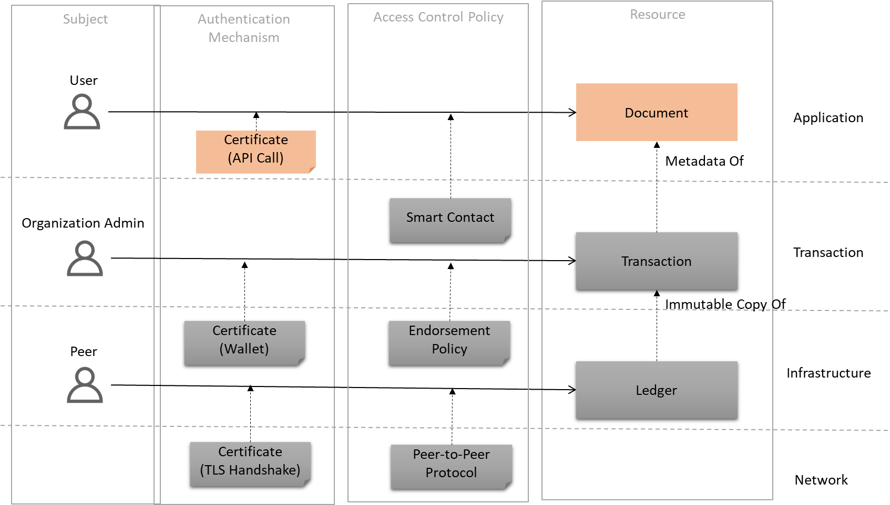
Layered Security Model for Zero-Trust

Slide 10
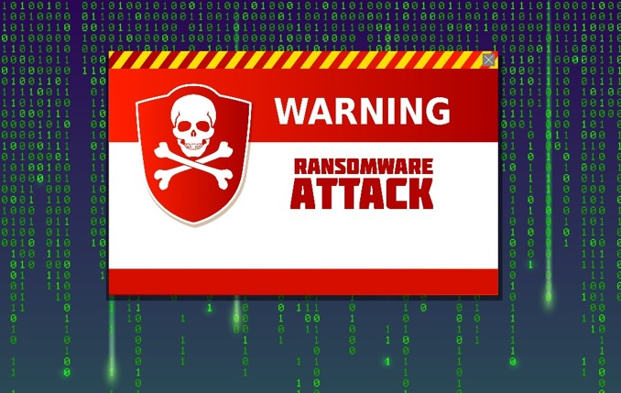
Next Steps: Ransomware Protection
File Data & Databases Safeguarded even if enterprise security is breached
Content may be quickly restored from Distributed File System
Control access to distributed file systems using blockchain
Access to content is granted based on policies published by the file owner
Preserve privacy and confidentiality of content stored in distributed file system
Encryption key protected using PKI

Slide 11
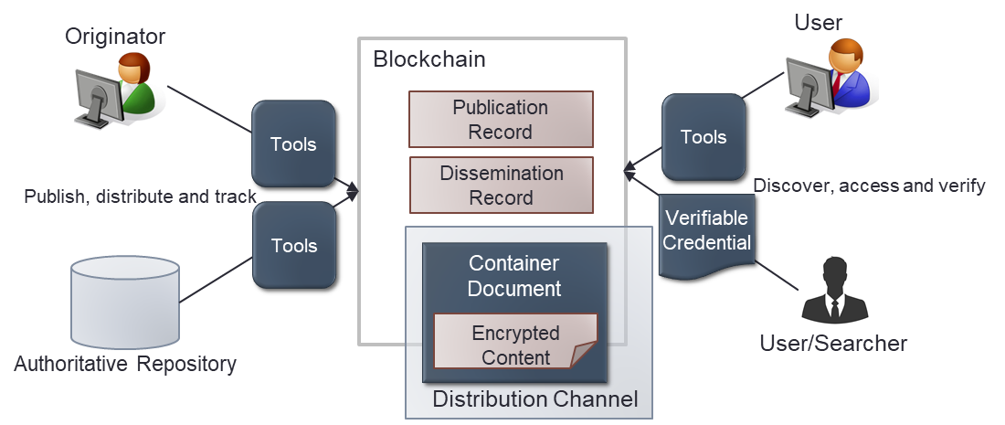
Summary
Sharing among teams – Information Visibility
Information consistency across organizations
Auditability and traceability beyond enterprise boundaries
Collaboration with partners – Built-in Zero Trust
Access control at every architectural layer
Transaction verification using PKI
Protection from adversaries – Infrastructure Resiliency
Cloud deployment enables continuity of operations
Distributed governance removes single points of failure inherent with local network/storage
Enterprise IT administration

